Slide 1
Find a recipe
CJ Vaughn
Bradley King
Bonnie Acuna
Laura Green

Slide 2
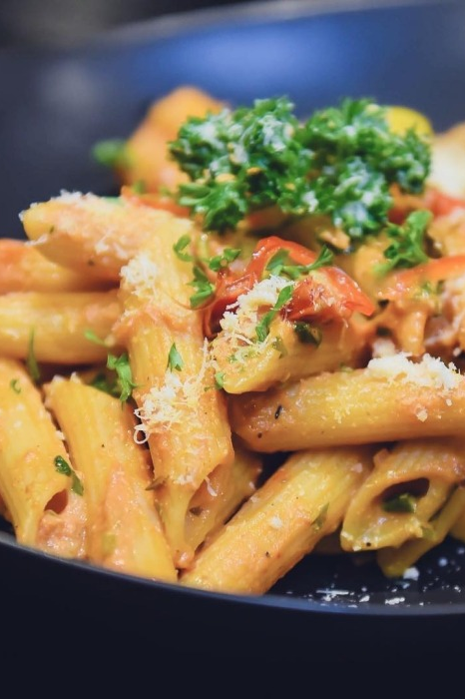
Delicious meals from your pantry
On any given day, families will have random items in their pantries. They may have overstocked or just decided not to use them for a meal or snack.
Find A Recipe allows users to put in a list of ingredients they have available and find a recipe that can be easily followed and available within a few clicks.
Each recipe will be listed in text with measurements, steps to cook, and an accompanying video for visual learners.
If a meal is well-liked, users can set the recipe as a favorite that will be available any time the site is accessed.

Slide 3

Why?

